Slide 1
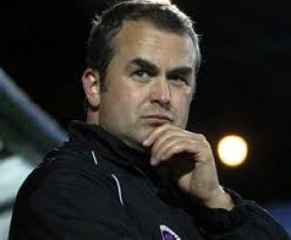
CHESTERFIELD FOOTBALL CLUB SACK RICHARDSON
Published on Wednesday 6 May 2009 17:46
Chesterfield 0 - Bradford City 2
“Chesterfield's season ended with a whimper and the frustration of a section of fans boiled over into acrimony as
there were repeated calls for manager
Lee Richardson to be sacked !”

Slide 2
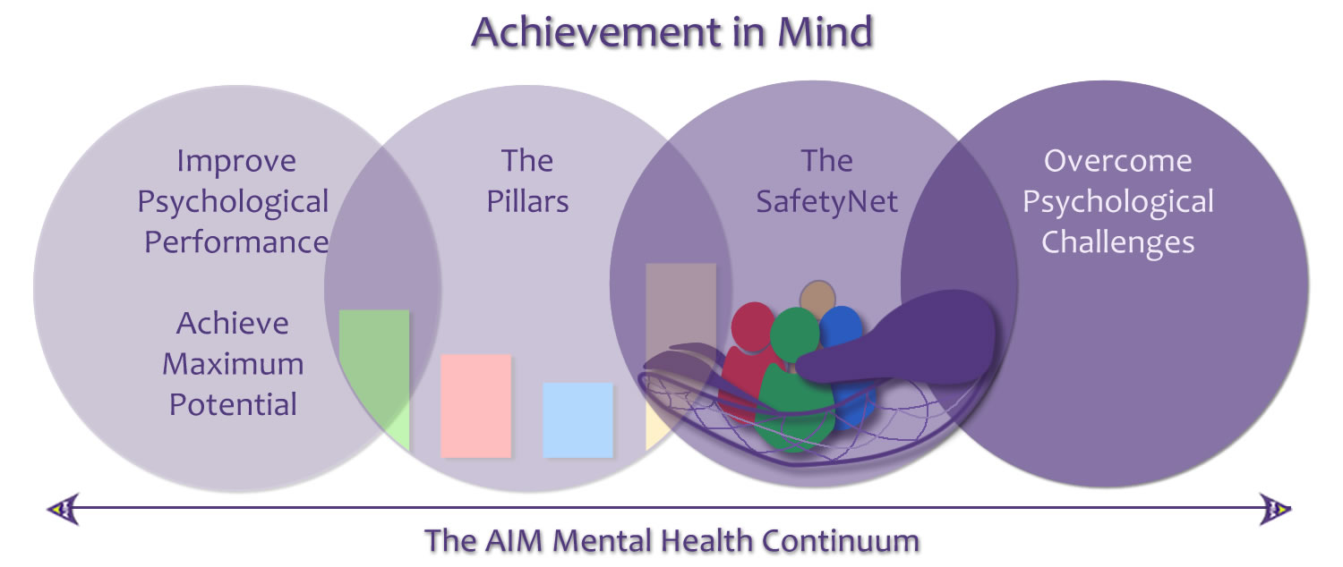
Competition Demands & The Continuum of Performance & Well Being/ Mental Health
Notes:
Competition demands / Burnout recognised challenges for Perfectionist sportsmen !

Slide 3
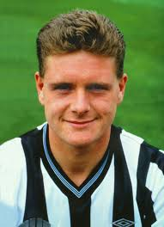
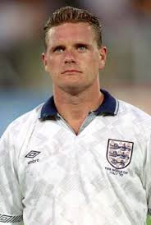
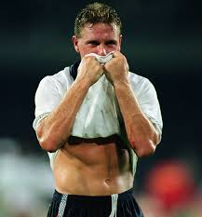
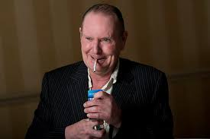
Performance & Well Being: High Profile Issues
Gascoigne's drinking problems started during his playing days - he was admitted to the Priory Hospital, near Southampton, in 1998, shortly after his divorce from wife Sheryl.
In 2008, four years after retiring, he was arrested in Newcastle and detained under the Mental Health Act.
Notes:
An Example perhaps!

Slide 4
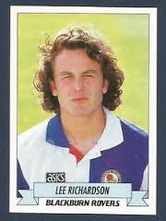
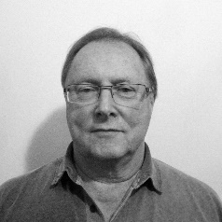
Origins of The Safety Net Experience & Education
Experiences in Professional Football began in 1988 age 16 (And Knowledge of Others , Nick & Younger Brother Joe released )
Embarked on Undergraduate study of Psychology 1997 Completed BSc Honours in 2004
Completed postgraduate MSc in Sport & Exercise Psychology May 2015
Whilst assistant manager at Chesterfield FC first contacted by Clinical Psychologist Peter Leakey around 2002-3.
Original Idea in 2009 after being sacked
Notes:
Experiences throughout 30 years !

Slide 5
Introducing The Safety Net
Notes:
Thank you going to try and cover the key points mindful of the time constraints !

Slide 6
Who and what is the Safety Net for?
Currently available to all Academies in Professional football (English)as a resource for Players, Parents, Coaches and other staff providing information and resources regarding mental health & well being issues.
Notes:
The Safety Net Psychoeducational resource currently in use throughout the academy system in professional football. Potential to contextualise to other environments.

Slide 7
The Objectives of the Safety Net
The Silent Majority 60%
In Sport ?
De-mystification
At the time Mental Health issues were even more misunderstood than at present especially in the Football Community. I had a belief that engaging footballers with easily accessible and user friendly content might enable better understanding of such issues.
De-stigmatization
In raising awareness regarding the reality of the Mental Health & Well Being continuum, the hope was that Mental Health issues would start to be seen as a normal consequence of competition demands of elite sport, life stressors and events and not as a sign of weakness.
Notes:
Key Objectives

Slide 8
The Objectives of the Safety Net
Accessibility & Confidentiality
To provide easily accessible and engaging resources providing educational information and support for mental health issues for Footballers and for individuals in close proximity to them.
Continuity of care
At the same time to provide the opportunity to improve continuity of care by providing a link through to other services (i.e. PFA counselling network)
Notes:
Continued

Slide 9
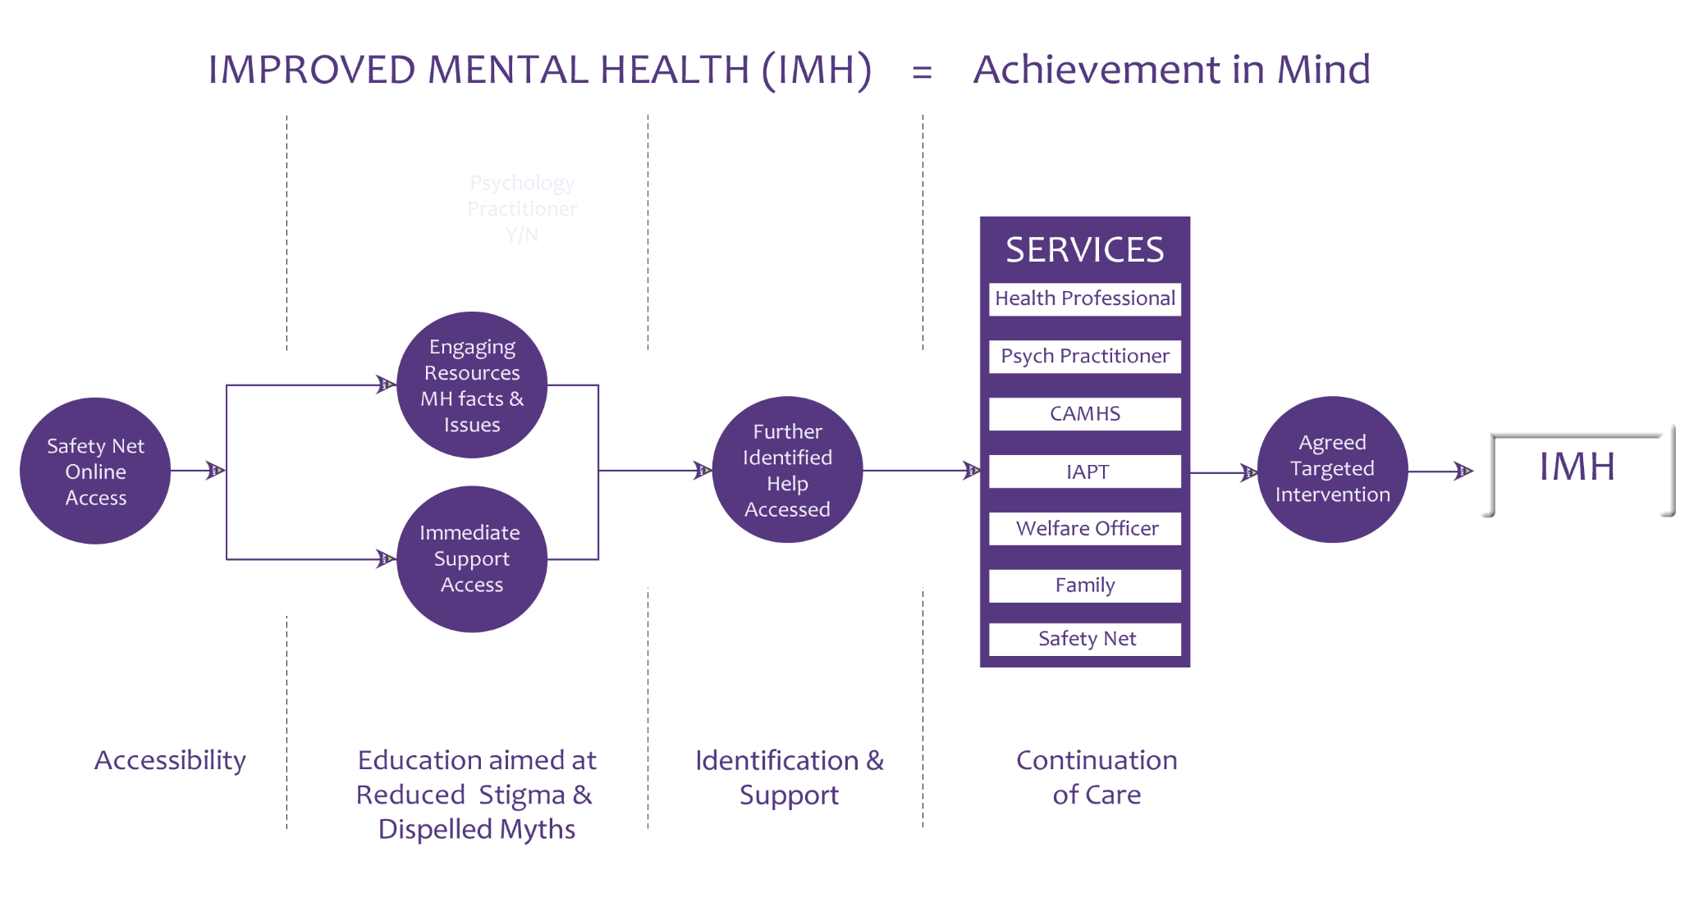
The Safety Net Process

Slide 10
Evidence base ?
Evidence based materials and information (NHS leaflets)
Growing evidence base for the efficacy of online Psychoeducational resources
Several focus group’s positive feedback
Initial PFA roll out began in October 2014 plans for a wider roll out for all Players potential in 2017
Usage numbers increasing with greater awareness: LFE
now fully engaged in roll out.

Slide 11
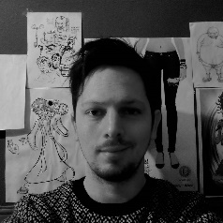
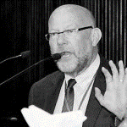
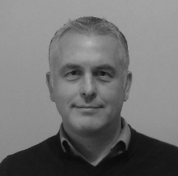
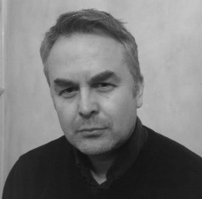
The Safety Net Team
Clinical Psychology Consultant: Peter Leakey BSc, Dip Clin Psychol.C.Psychol.AFBPs
Creative Consultant (Animator): David Leakey BA
Advisor: Professor Graham Turpin BSc, MPhil, PhD.
Technology Architect: Nick Richardson BSc, QTS
Founder: Lee Richardson BSc, MBPsS
Notes:
The Team !

Slide 12
Thank you! Any Questions?

