Slide 1



Sports Chaplaincy UK Wales Conference 22nd June 2017
WELCOME!
and welcome to the home of
Gwernyfed RFC...

Slide 2
Day's overview:
9.40am - Arrival - tea / coffee
10 - Kick off - Welcome, then Devotional – Ifor Williams
10.15 – CEO - a quick view from the bridge
10.30 – Dealing with trauma and tragedy – Steve Jones
12 - Lunch - provided - £5pp (inc tea/coffee etc) - honesty box
12.45 pm – Possibilities of Partnering - Susan Lloyd-Selby - Foodbank & Gideons update
1.05pm – Developing a world class attitude – Gerrit Bantjes
1.40pm - Welsh Wonders - What's hot, what's not - Chaplains share and prayer....
  Heather Lewis selected as Chaplain for World Para-games
  Phil Bishop – “Transform your team”
  Steve Jones – developing disability chaplaincy
2.00pm – Prayer Power
2.15pm - break - tea/coffee
2.30 - Warren – SCUK update
2.50pm - Vision Wales – progress update - Martin
3.15pm - Disability sport taster session or
Thank you for coming, closing prayer, good byes...

Slide 3
Warren Evans, CEO Sports Chaplaincy UK

Slide 4
Dealing with Tragedy and Trauma Risk Management in a club setting

Slide 5
Scenario (1)
You are the club chaplain and you receive a call late Sunday evening from the team manager with the sad news that one of your team’s players has been killed in a road traffic accident. The following evening’s training session has been cancelled but the team manager is getting all the playing squad and coaches together and he asks you to address them.
What do you do when you put the phone down?
What do you plan to do/say on the Mon evening?
What do you do in the following days, weeks and months? And for who exactly?

Slide 6
Scenario (2)
You are the club chaplain and are watching from the touchline or stands the team’s home fixture against an opposing side. Unexpectedly during the match one of your team’s players collapses, suffers cardiac arrest and cannot be revived.
What do you do immediately?
What do you do for the rest of the day?
What do you do in the following days, weeks and months? And for who exactly?

Slide 7


Areas / factors to be considered in the response of pastoral care and in trauma management
Location
people
timings
Follow-up
literature

Slide 8
Pastoral care in a team setting……some suggestions :-
Choose a ‘warm’, relaxed setting : lounge, function suite, quiet bar area. Not an academy classroom !
A word of ‘assurance’ - ‘what you are undergoing through are the normal symptoms of shock and grief.’
Know the stages of grief : and briefly explain them
A word of ‘encouragement’: ‘do talk about what / how you are feeling’ : ‘it is a strength of character and not a weakness to be willing to talk’
Active remembering : to initiate and help process the trauma/ grief: Condolence book(branded) / Victim Facebook page: silent reading of tributes/

Slide 9
Memory card activity : ‘shoulder to shoulder’ reading of them
Refreshments available: people talk better over a drink
Male and female chaplaincy/ pastoral presence
coffee shop gift cards : an incentive to take the decision to meet and talk
Prayer?
Do not assume you will be taking the funeral: the family’s choice of funeral celebrant is of first importance
Prayer cards on anniversaries of the death/ incident

Slide 10
Trauma Risk Management
What is it?
A support system that aims to ensure that trauma-exposed personnel/ players are supported and encouraged to seek timely help should they develop mental health problems that fail to resolve spontaneously

Slide 11
What does it involve?
Trauma Risk Management Handbook: to be given to each player/ person associated with the club.
2) Trauma Risk Assessment/ Awareness Meetings ( TRAM) between player , chaplain and club welfare officer : Initial meeting within 72 hours of traumatic incident
A player scoring highly on traumatised/ stress scale in initial interview provided with a follow-up TRAM meeting one month later to assess how well they have come to terms with the traumatic event at that point.

Slide 12
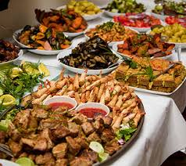
Lunch Time!

Slide 13
Key Dates for your Diary...
Oct 4th & 5th Oct – National Conference inc 25th celebrations @ Lighthouse Church, Salford, Manchester
Feb 8th 2018 – our next Wales conference

Slide 14

SPORTS CHAPLAINCY CONFERENCE
JUNE 2017
Susan Lloyd-Selby
Area Manager
S.Wales
trusselltrust.org

Slide 15

The Trussell Trust
A charity founded on Christian principles that works with people of all faiths and none
A network of independent Foodbanks run in line with Trussell Trust core elements
Driven by our Mission verse (Matt. 25: 35-40)
Our aim – to challenge injustice & give a voice to the voiceless
Our passion: in 2017, no-one in the UK should go to bed hungry or cold!

Slide 16

Why here, why now?
13 million people in UK live below the poverty line
Wales is the poorest part of the UK (outside London)

Slide 17
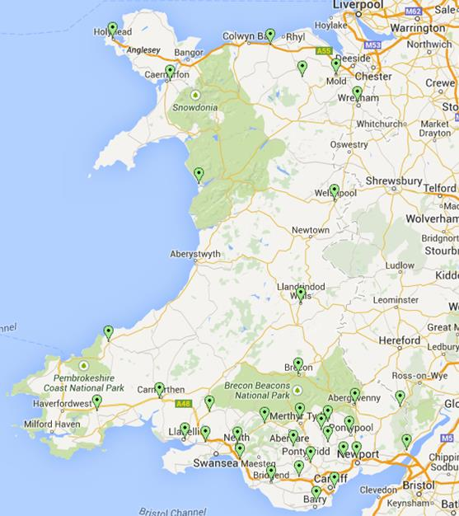
Why Here? Why Now?
416,205 three-day emergency food parcels in Wales since 2010
Last year - 96,248 (35,141 to children)
892 tons food given away
37 foodbanks
110 centres
1,500 + volunteers

Slide 18
Where we are
Abergavenny
Abergele
Ammanford
Anglesey
Arfon
Barmouth
Blackwood & District
Blaenau Gwent
Brecon
Bridgend
Caerphilly
Cardiff
Cardigan
Carmarthen
Chepstow
Eastern Valley
Flintshire
Llanelli
Llandrindod Wells
Merthyr Cynon
Monmouth & District
Neath
Newport
Oswestry & Borders
Pembrokeshire
Pontypridd
Port Talbot
Prestatyn & Meliden Foodbank
Rhondda
Rhymney Valley
Risca
Swansea
Taff Ely
The Vale of Glamorgan
Welshpool & District
Wrexham
Vale of Clwyd Foodbank

Slide 19
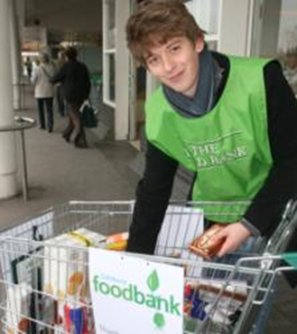
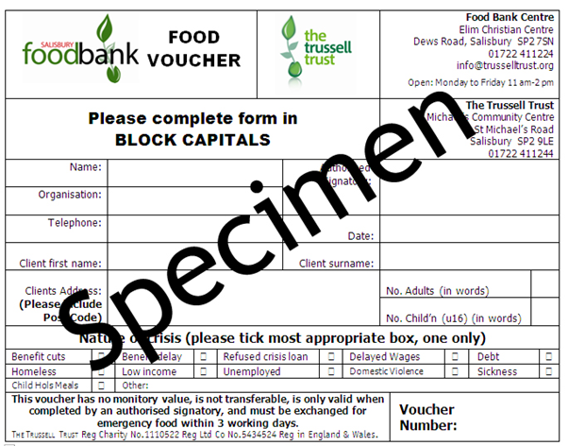
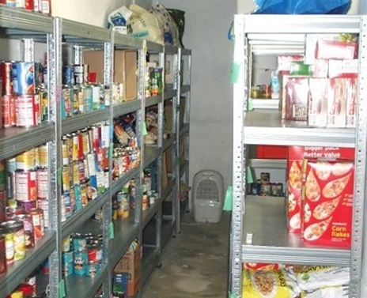
How foodbanks work
Non perishable food is donated by the public
Food is weighed in, sorted & stored by volunteers
Frontline care professionals give foodbank vouchers to people in crisis

Slide 20
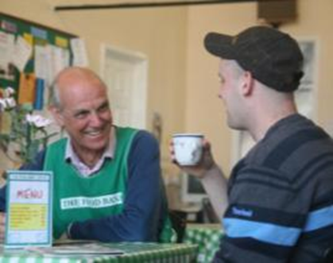
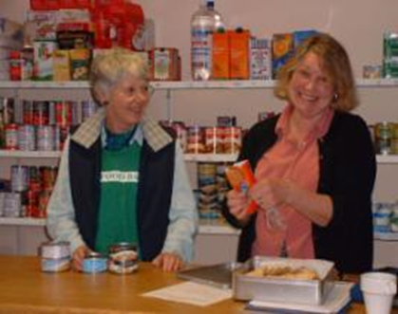
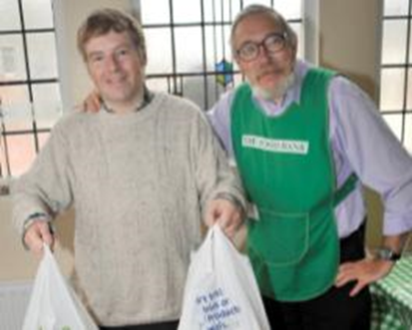
How foodbanks work
Clients exchange their voucher for 3 days’ supply of food at the foodbank centre
Foodbanks take time to listen and signpost clients to further support. When appropriate, we offer to pray with the client

Slide 21
More Than Food
We want to catch people ‘up steam’ before they reach a crisis point
Eat Well, Spend Less - basic budgeting and cooking courses
Fuel Bank - provides £30/£49 credit to people on pre-payment meters
Energy Bank – equips volunteers to signpost clients to support with fuel debt and efficiency
Holiday Clubs – helps address holiday hunger
Money Life – a suite of tools and courses to help tackle debt and financial difficulties.

Slide 22
Possible opportunities for engagement?
Food collection points
Give us a game (bucket/food collection)
Player support for holiday clubs – coaching session?
Tickets to events e.g. Penarth Rugby club/CCFC
Seasonal support e.g. CCFC website publicity & collection point for toys
Volunteers for food collections

Slide 23
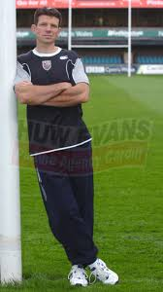
Gerrit Bantjes
Former 1st class rugby player for 8 yrs
Fitness coach with Cardiff RFC for 3 yrs
Selected for Parachute Regiment at age 40
Now works with Care for the Family developing men's support and development
Developing a
World Class Attitude

Slide 24



CAPABILITY
COMPETENCY
CHARACTER
Notes:
So why is “character” seen as so important to the ABs?
What is character?
Write 3 adjectives that describe your character?

Slide 25
A quick reminder of some aspects of Character
we have looked at today:
Attitude
Hard Work
Consistency
Discipline
Trust
Respect
Serve others
Do the right thing
Humility
Gratitude

Slide 26

tea/coffee break

Slide 27
Welsh Wonders –
What's hot, what's not - Chaplains share and prayer....

Slide 28

Key values of Sports Chaplaincy
Presence
Excellence
Relationship
Confidentially
Humility
It’s all about Jesus and being his hands and feet
Notes:
Spiritually these values express Christ values –its about our very being – BEING
- Present – being there, being a difference - Incarnational: “The word became flesh dwelling among us.” “let your light shine”
Excellent – in everything we say and do – we serve an excellent God, Servanthood: “not looking to your own interests, but the interests of others.”
Relationship – compassion - Identification: “all things to all people” “Love your neighbour as you love yourself.”
- Confidentiality – trusted, safe port of call
Humility – its all about Jesus
Minimum standards: Commitment to prayer, Servant heart, Pastoral gift, Accountable (reference), Adhere to safeguarding, Consistent attendance at sporting organisation outside of ‘event / match’, Commitment to ongoing development

Slide 29

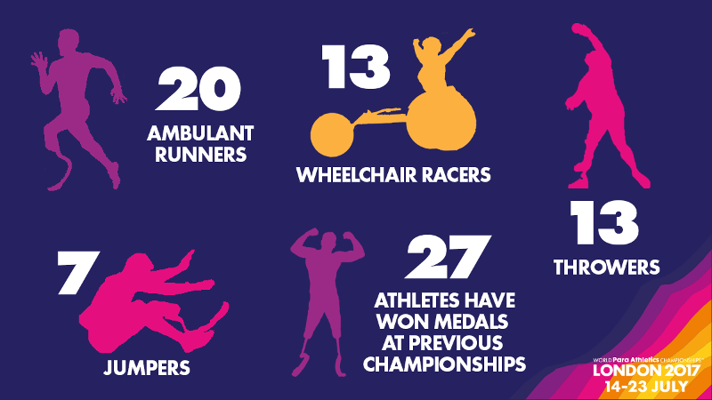
14th – 23rd July 2017 London Stadium
168 Countries
1,300 Athletes Competing
49 Para Athletes in Team GB
9 Welsh Athletes
Notes:
From 14th – 23rd July 2017 168 countries, 1,300 athletes taking part – some countries only have 1 representative. Team GB have 49 athletes of which 9 are from Wales.

Slide 30

London2017 World Championship Medals
Notes:
The medals for the Games. On the back of the medals its in Braille. These medals have been made to last and not rust like the ones from Rio in 2016

Slide 31
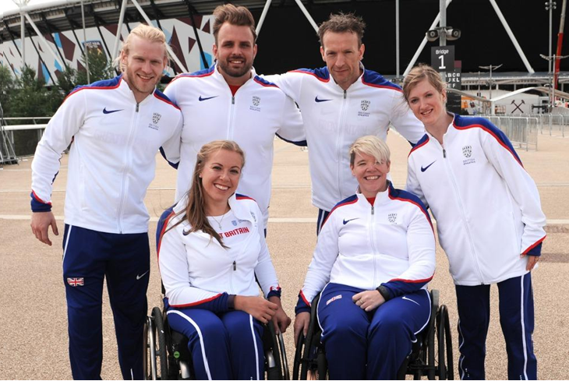
Jonnie Peacock
T44 – 100m
Aled Davies
F42 – Shotput & Discus
Richard Whitehead
T42 – 200m
Hannah Cockcroft
T34 – 100, 200 & 400m
Jo Butterfield
F51 – club & Discus
Sophie Hahn
T38 - 100 & 200m

Slide 32
Chaplains for the Games
Joel Thibaut – France
Desiree Frierson – USA
Cristobal Chamale – Guatamala
Natalja Pelepeca – Latvia
Debbie Flood – GB
Carolyn Skinner – GB
Heather Lewis - GB
Notes:
The Chaplaincy Team. However there is no chaplaincy centre to work from, so people will be left to try and find the hotels where teams are staying and try and have conversations there or just amongst the crowd at the stadium

Slide 33

9 Welsh Athletes
Aled Davies
Kyron Duke
Hollie Arnold
Olivia Breen
Sabrina Fortune
Jordan Howe
Steve Morris
Rhys Jones
Notes:
These are the Welsh Athletes that will be competing, some of whom if they don’t perform wont have funding

Slide 34


Glamorgan CC
Sports Chaplaincy Wales June meeting

Slide 35
“Transform you team” weekly newsletter
“Inspirational and thought-provoking as always” CEO Cricket Wales.
“Thanks for your email and welcome to Glamorgan CCC. I look forward to meeting you at the SWALEC stadium soon” Deputy Chairman
“Thanks Phil – a lovely start to the week” Head of HR
“Thank you – so very true!!” Head of HR

Slide 36
Pastoral Postcards
Happy Birthday
Congratulations
Get well soon
Blank

Slide 37

Gideon's Bibles

Slide 38
Memorial
JOHN 11:35 – HE WEEPS WITH US (note the O in John is to be a poppy)
There’s Armistice Day – the 11th month, on the 11th day, at the 11th hour, a time where we remember those who suffered and sacrificed their lives for us so we could have a better today.
We also remember those who have contribute so much to sport in Wales. This memorial is to remember them and the contribution they have made to their community, sport and cricket clubs in Wales. May we Remember them, that when we weep – we don’t weep alone.
There are many ways to remember someone special, and each individual is unique. But, for those who loved sport and the game of cricket especially Glamorgan CC and Welsh Cricket, wouldn't it be wonderful to pay tribute to them by continuing to support the things they cared about? A gift to their memory to the Cricket in Wales Fund, will be a continuing memory of your loved one – forever It will also will help to continue to transform people’s lives in the community.

Slide 39


Charity Connection

Slide 40


Volunteering & Serving

Slide 41


Thank you
Community thank you
Fun and enjoyment

Slide 42


Pushing the Boundaries
Supporters Groups

Slide 43
Vision
Wales –
To keep on growing

Slide 44








... progress in Wales
3 Chaplains working across various disability sectors
We are having / trying to have discussions with:
DSW Wales-wide
Cardiff Devils ----- Cardiff City
Abercwmboi, Bedwas, Beddau, Newbridge, Methyr, Bath, Neath RFCs
Tranmere and Prestatyn FC
WRU, WRPA
Welsh Netball
Event Chaplaincy

Slide 45

Sports Chaplaincy (initial) model for Wales
Wales Action Plan 2017:
Increase chaplains connectivity
> Whats App group
> Monthly “hour of power” prayer time
> Sharing ideas and resources
> Effective regionals
> Pastoral contact and encouragement
Increase no of chaplains by:
> regional focus
> chaplain get chaplain
> Inclusivity
> more church assignments
Increase SCUK awareness
> regional focus
> more church assignments
> each chaplain at own church + 1
> widen networks e.g. Men's breakfasts ,
BU trng days, Ev Now , Waleswide, Elim
> qrtly / half yrly e-updates
> improve supportive glossys etc
Increase financial support
> all chaplains paying m’ship fees
> church etc support through above
> encourage friends to support
> partnership support
> grants/funding opps
Increase partnerships in Wales
> Sporting bodies
> Church / Christian organisations
N Wales
1 day pw*
Develop chplncy opps 4 all sports across N Wales & support N Wales chaplains
Steve J
W Wales
1 day pw*
Support
Wales
Develop chplncy opps 4 all sports across W Wales & support W Wales chaplains
Martin – overall lead / driver
Develop chplncy opps 4 all sports across S E Wales & support chplns, support & develop all Wales, lead SCUK work across Wales, support regional leads
Support*: arranging trng days, regionals, prayer shares , church contacts, admin etc
* - assumes being paid and to become 2/ 2.5 days pw

Slide 46
Wales Progress.....
Spiritually ??

Slide 47
Key Dates for your Diary...
Oct 4th & 5th Oct – National Conference inc 25th celebrations @ Lighthouse Church, Salford, Manchester
Feb 8th 2018 – our next Wales conference

Slide 48
Thank You for coming, trust you enjoyed the day, let’s pray, stay for visually impaired games, and/or have a safe trip home!

